Slide 1
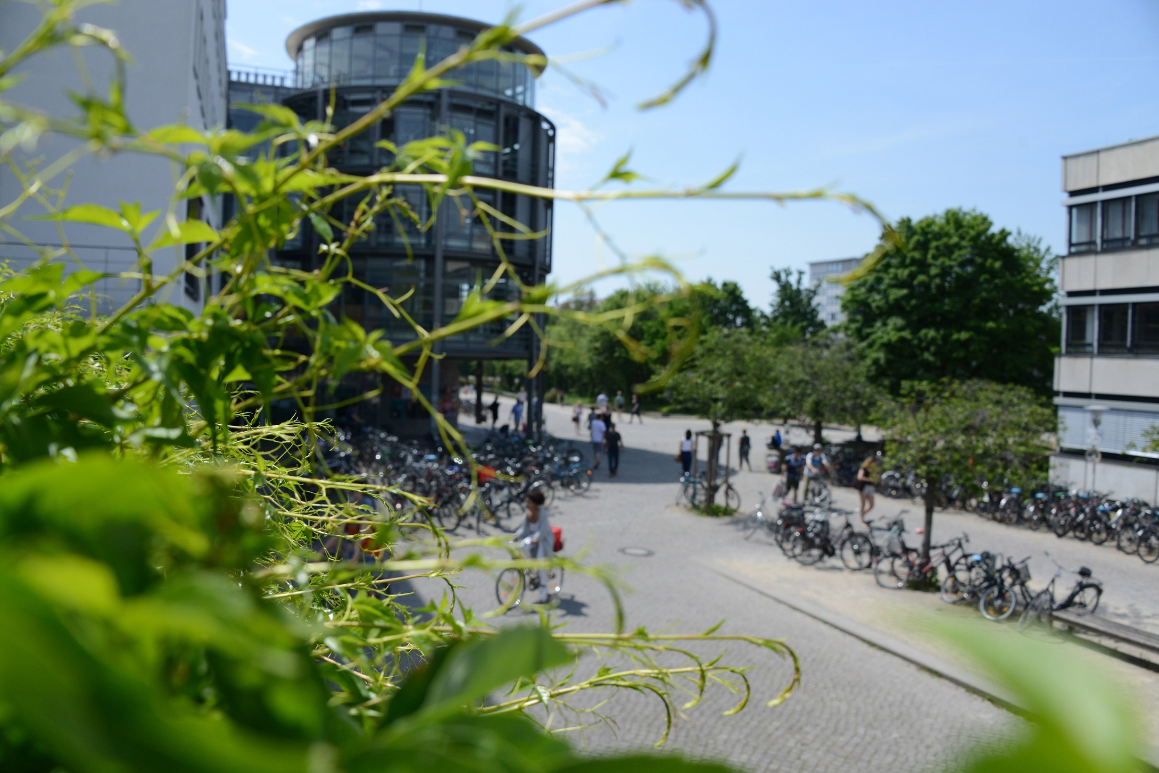
The University of Göttingen
The University of Göttingen
Matthias Mustername
An Introduction

Slide 2
Profile of the University of Göttingen
Founded in 1737 as the University of Enlightenment
In 2003 the University became Foundation under Public Law
Research university of international importance
Focus on research-based teaching
Around 27,5000 students, of which 16,7% are international
13,300 employees (incl. the University Medical Center)

Slide 3
Foundation Under Public Law since 2003
Legal independence of the University from the state of Lower Saxony
Economic management and accounting conform to business principles
Employer with legal authority
University's properties constitute basic assets of the Foundation
High level of autonomy and leadership

Slide 4
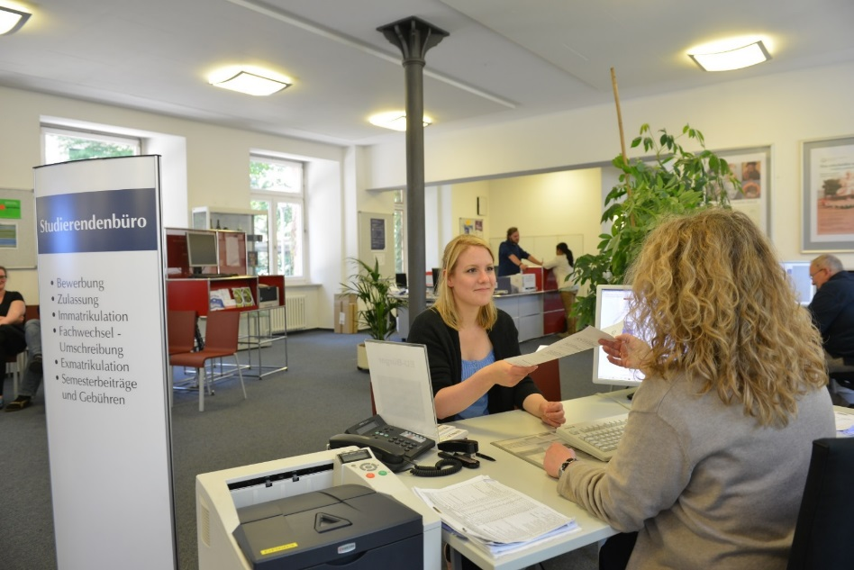
Largest Employer in the Region
13,300 employees at the University and the University Medical Center
4,500 employees in scientific field
8,800 employees in non-scientific field
46% female employees
High internationalisation level – 12% of the university´s employees are international
(Status 2022, all figures rounded)

Slide 5
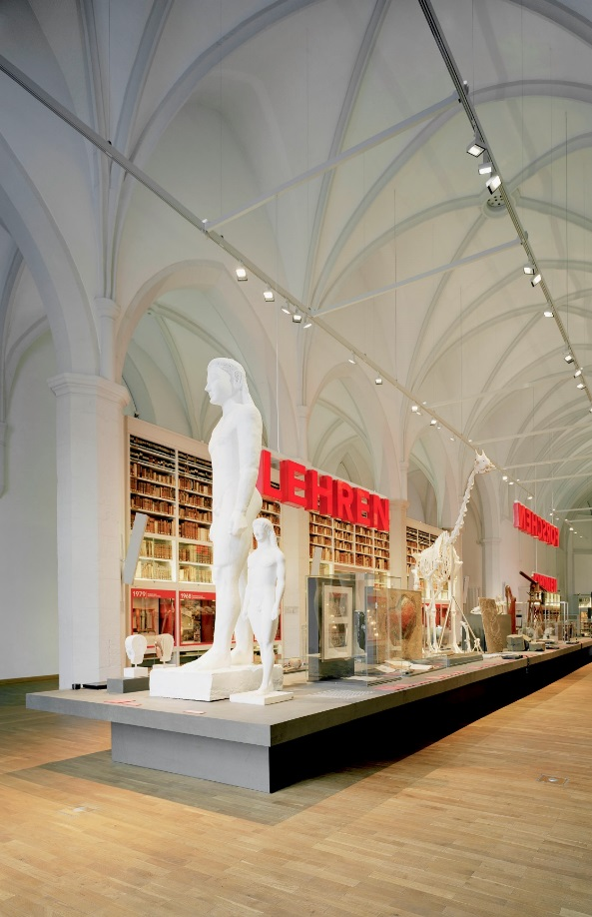
Faculties
The University of Göttingen comprises 13 faculties in:
Humanities and Theology
Chemistry, Physics, Biology and Psychology
Mathematics and Computer Sciences
Agriculture, Forestry and Geosciences
Law, Economics and Social Sciences
Medicine
Centers, institutes and affiliated institutes complete the profile. They offer unique opportunities for interdisciplinary cooperation.

Slide 6
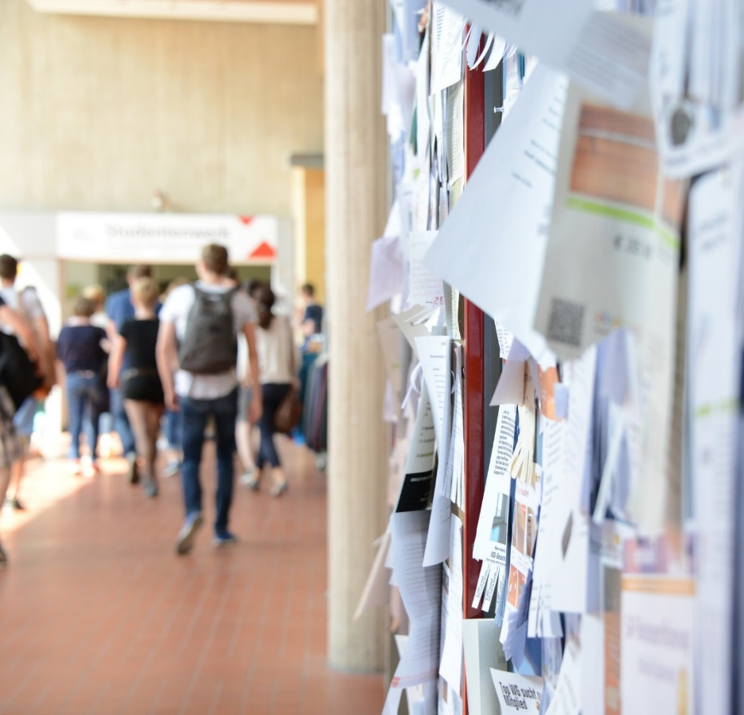
Popular Among Students
More than 27,500 students in winter semester 2023/2024
4,500 students from abroad
210 different degree programmes
Diversity of subjects and possible combinations in study programmes

Slide 7
Our Quality Standards in Teaching
Research-oriented teaching
Disciplinary and interdisciplinary study programmes
International curriculum
Diversity and equal opportunities
High quality of advice and support
Innovative teaching and exam forms

Slide 8
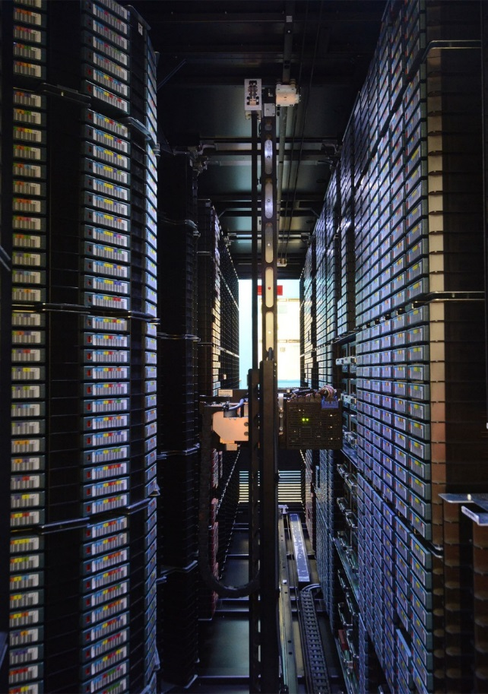
Infrastructures
Digital transformation and increasingly interconnected science place high demands on the management of complex and heterogeneous data.
Central partners of the University of Göttingen in the field of Development and Operation of Information and IT Infrastructure are
the Lower Saxony State and University Library (SUB)
the Society for Scientific Data Processing mbH Göttingen (GWDG)
They bundle their expertise and experience in the Digitalisation Center and the eResearch Alliance, founded in 1997 and 2014 respectively.

Slide 9
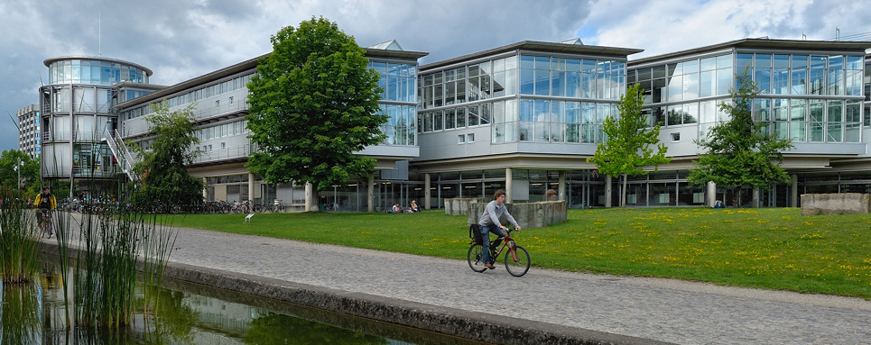
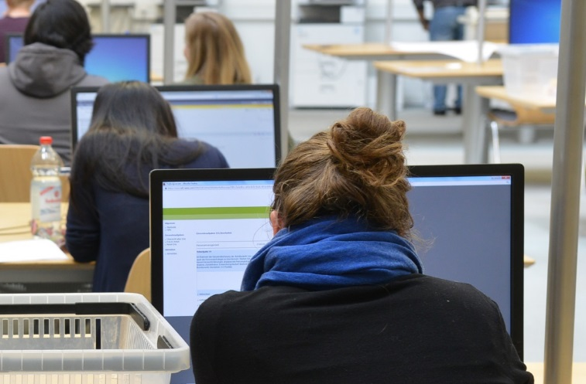
Lower Saxony State and University Library Highest Standard for Research and Teaching
Securing and expanding research and information infrastructures
Expansion of Open Access and electronic publication forms
Provision of information to students, educators, and researchers: 5.8 million books, 1.5 million microforms, 34,000 electronic journals, extensive digital collections, and numerous maps, plans, manuscripts, and incunabula

Slide 10
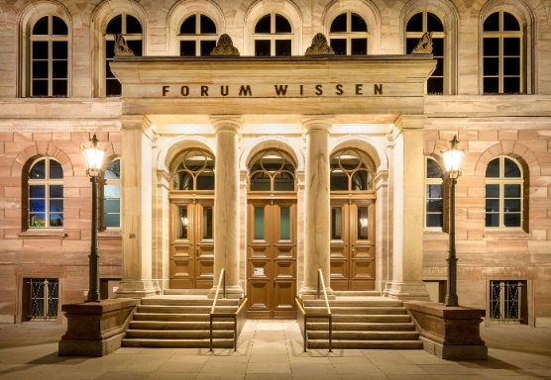
Science Explained
The Forum Wissen stands for dialogue between science and society. It is designed as
modern science museum
place of interdisciplinary research and teaching
center of encounter between science and general public.
The public's great interest in science is also reflected in the Göttingen Night of Knowledge, which was visited by more than 25,000 persons in 2022.

Slide 11
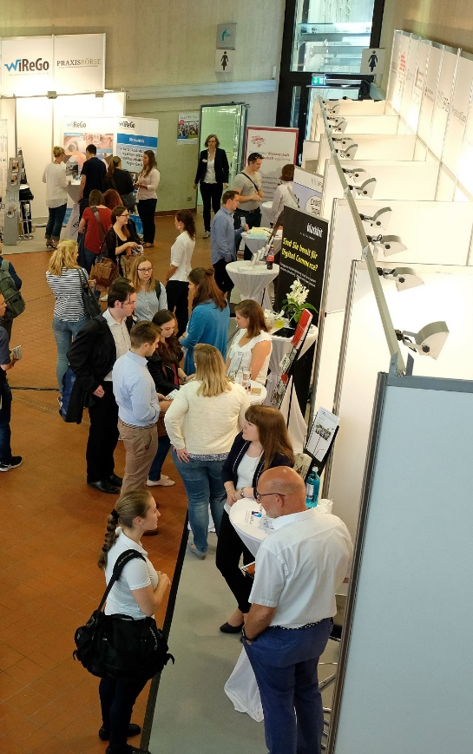
Science and Economy in Dialogue
The University promotes the integration of science and economy.
The goal is to promote innovation through
exchange between students and companies about research projects
qualification through practical experience
direct access to scientific expertise
mentoring by executives.

Slide 12
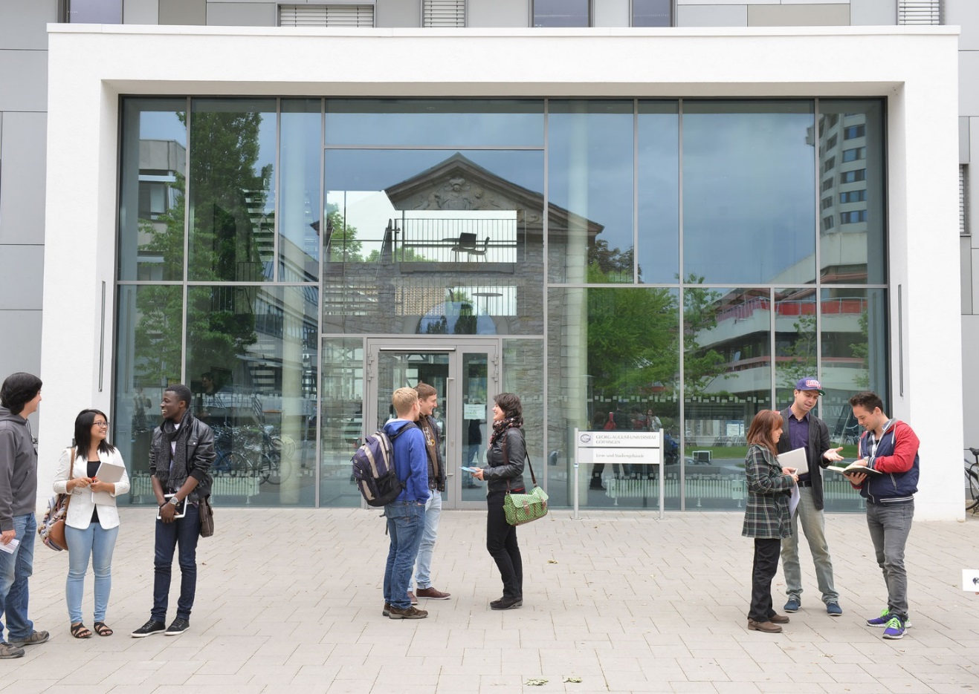
Göttingen One University – Many Opportunities

