Slide 1
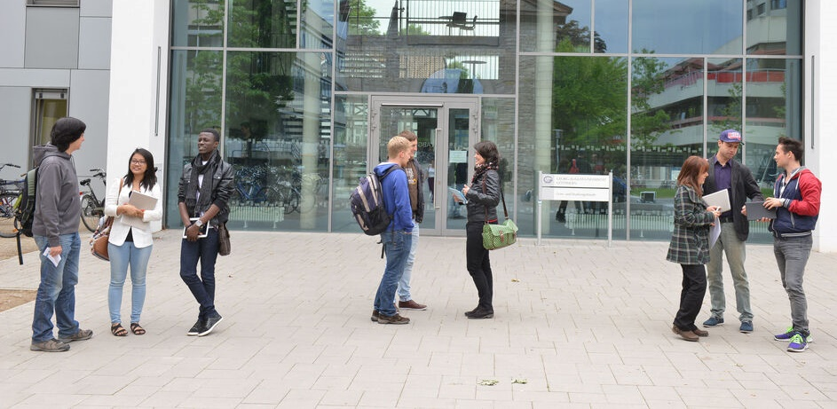
THE UNIVERSITY OF GÖTTINGEN

Slide 2
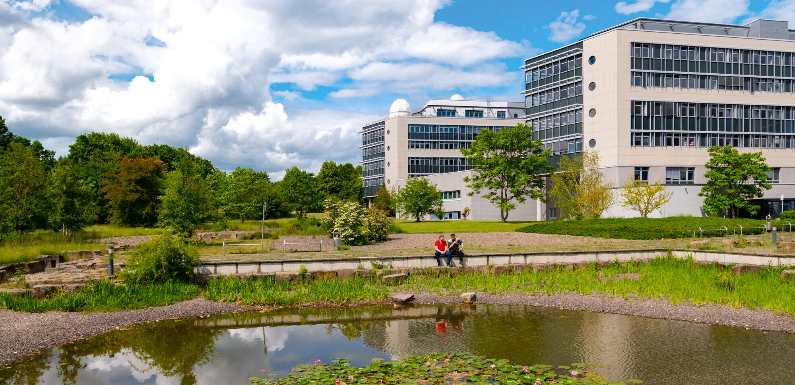
RESEARCH
Among the top 3 German universities for research units and research training groups
research training groups
12
with coordination
7
DFG research units
with coordination
9
Collaborative Research Centers
with coordination
Status: 2024

Slide 3
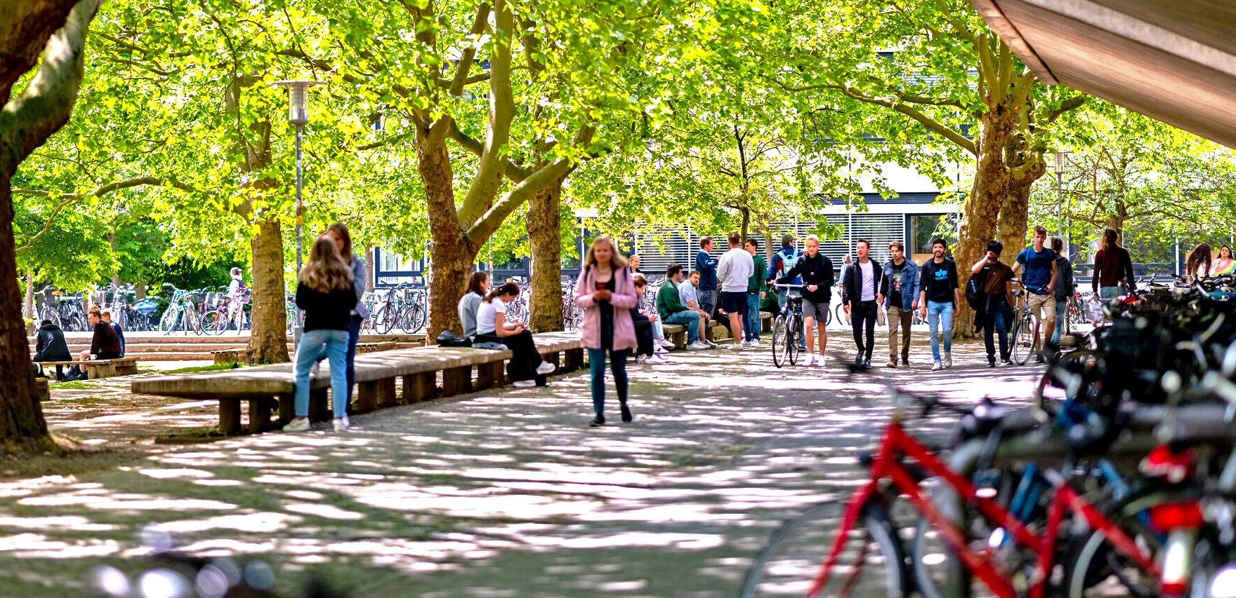
STUDYING
13 faculties
with subjects in natural sciences, life sciences, humanities, social sciences and medicine
>230 degree courses
27.500 students
16% international
students
top positions in the university rankings
Status: WiSe 23/24

Slide 4
GRADUATE SCHOOLS
All PhD students at the University of Göttingen are member of a graduate school:
Georg August University School of Science (GAUSS)
Göttingen Graduate Center for Neurosciences, Biophysics, and Molecular Biosciences (GGNB)
Göttingen Graduate School of Social Sciences (GGG)
Graduate School of Humanities Göttingen (GSGG)
Graduate School of Forest Sciences and Agricultural Sciences (GFA)
703
completed doctorates over five years
Status: 2024

Slide 5
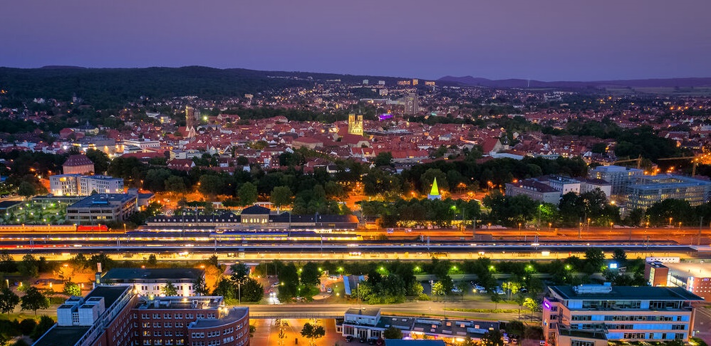
DER GÖTTINGEN CAMPUS
THE GÖTTINGEN CAMPUS
9
research institutions
of which are 4 Max Planck institutes
15
associated partners
> 5.900
researchers
in almost all scientific disciplines
Status: 2024

Slide 6
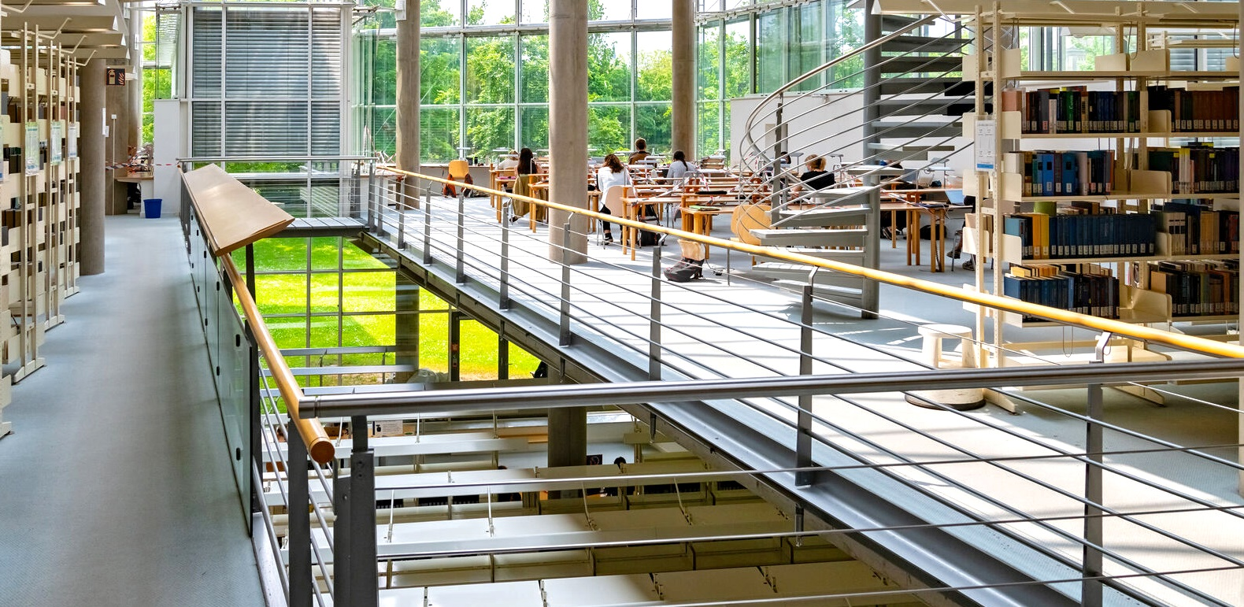
SUB
Lower Saxony State and University Library
9.9 million
total media holdings
15 million
book pages digitally accessible worldwide
1.9 million
annual library visits
Status: 2023

Slide 7
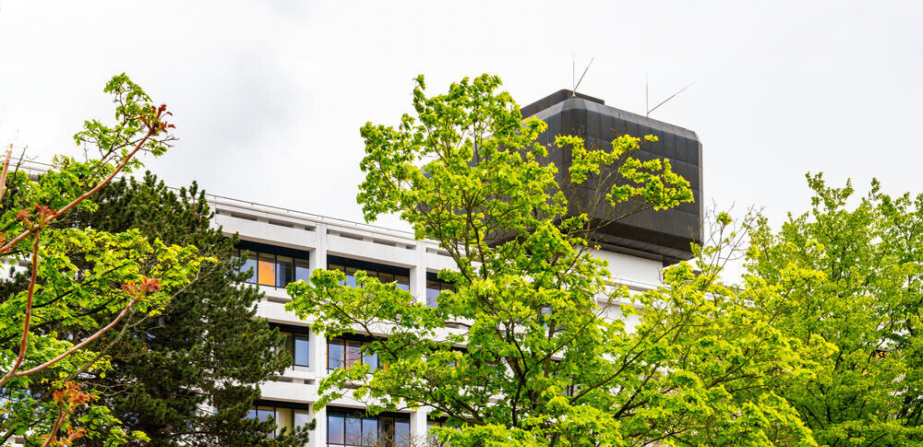
LARGEST EMPLOYER IN THE REGION
4953
employees university
8105
employees UMG
excluding auxiliary staff
excluding auxiliary staff
thereof
404
professors
thereof
111
professors
2092
scientific staff
1849
scientific staff
Status: 2023

