Slide 1
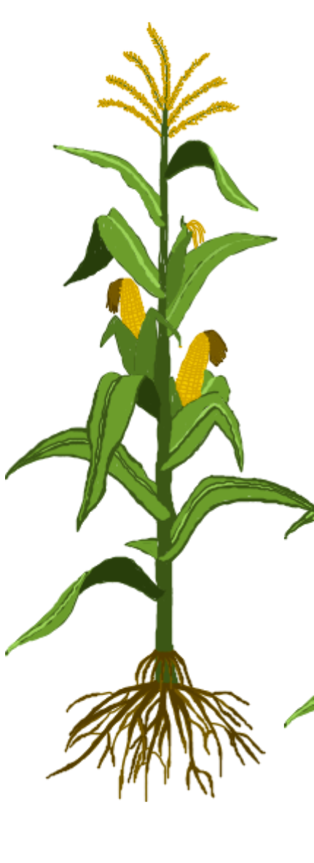
Comments on heritability, regression of genotypic value
on phenotypic value, accuracy, reliability and
what-is SNP-based h²?
24. August 2022 wlink@gwdg.de
By the way: Co-variance between X and X is Variance of X
Correlation between plant height measured at 8:00 and plant height measured an 10:00 at the same day is about r=1.0 ;-)
Covariance between the two ‚traits‘ is about variance of plant height at 8:00 which is about variance of plant height at 10:00.
what-is SNP-based h²?
© Mila Tost

Slide 2
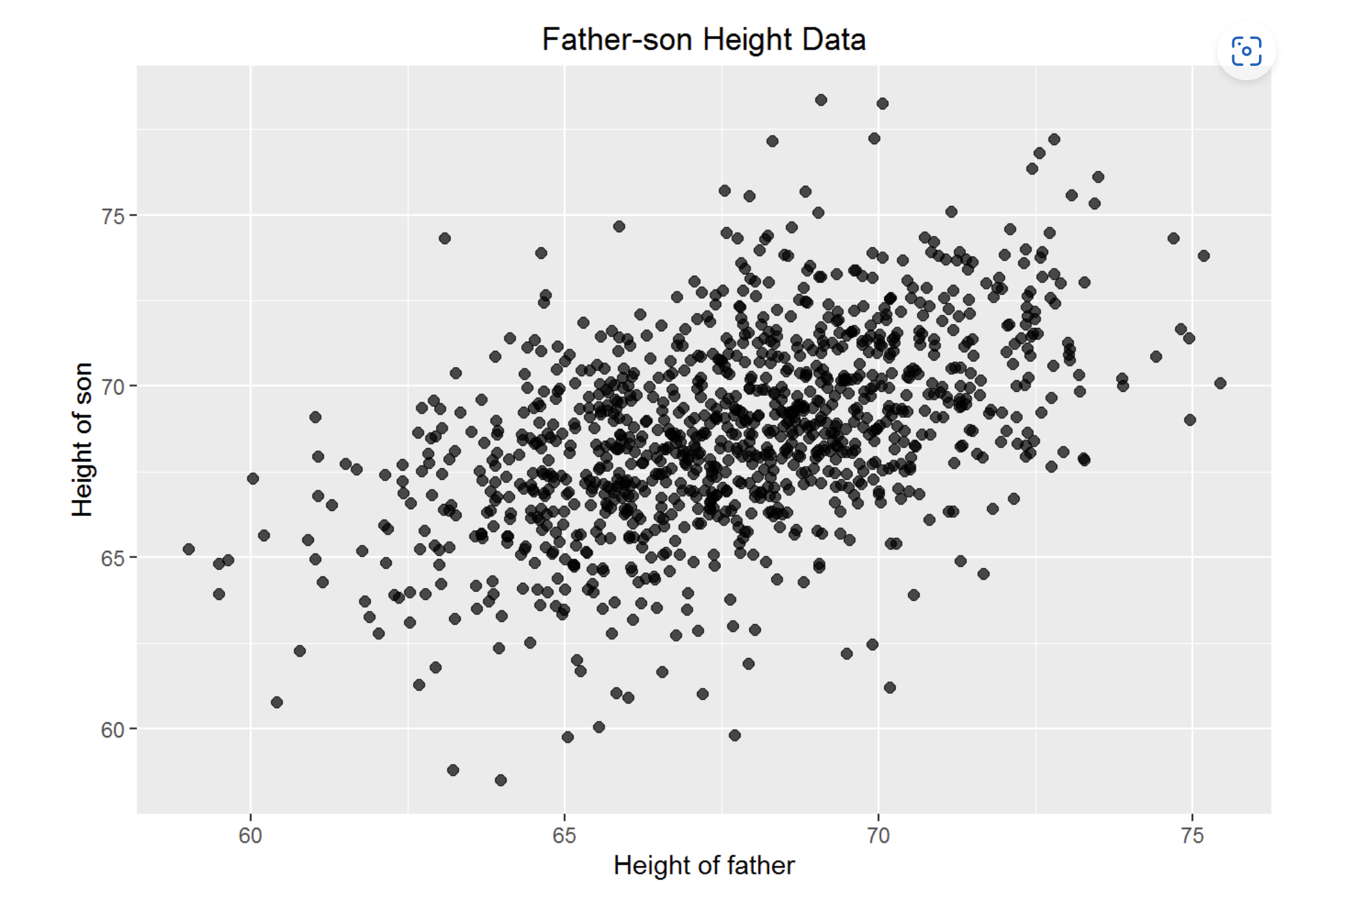
The famous Galton’s father & son body height data, the begin of regression analyses (regression toward mediocrity)

Slide 3
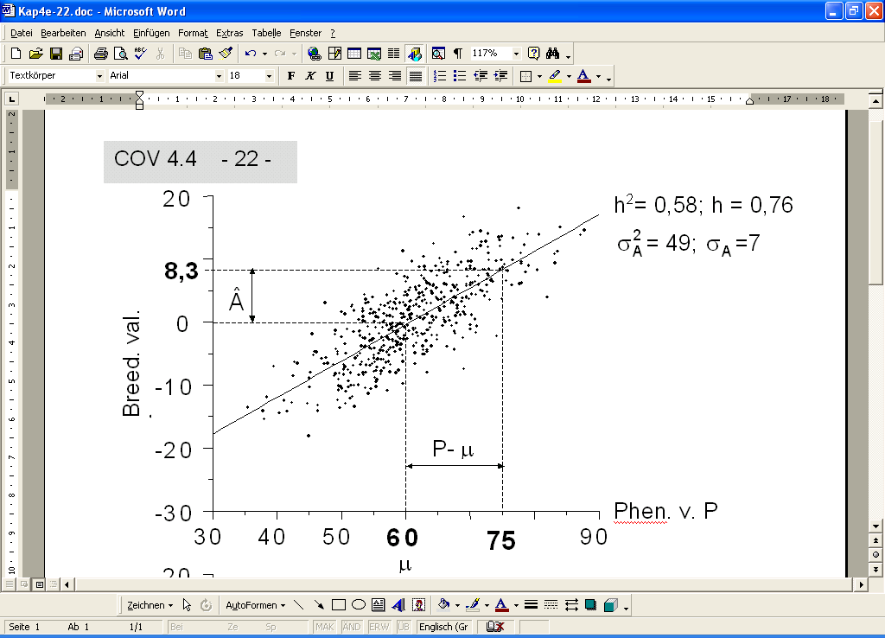
A

Slide 4
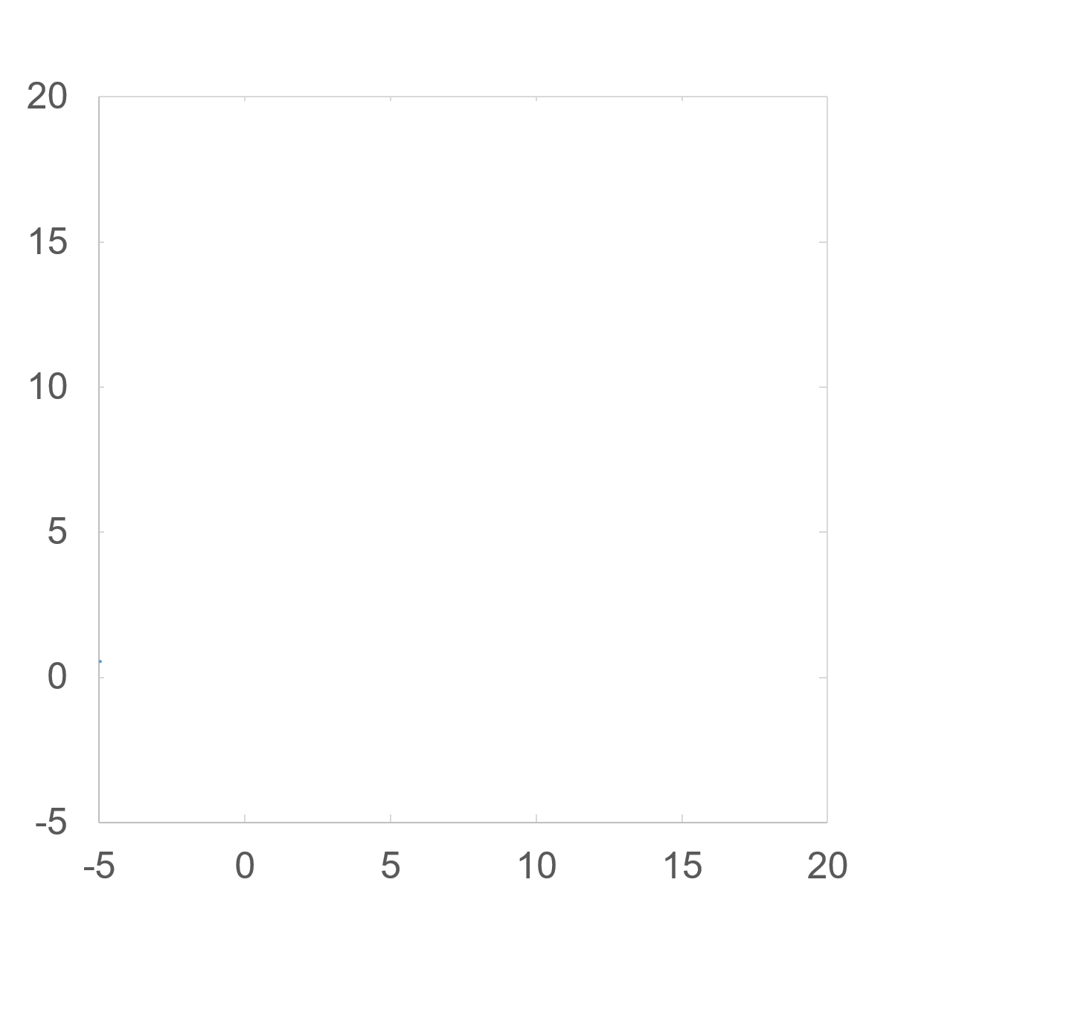
Correlation = Co-Variance / SD(X)∙SD(Y)
Regression = Co-Variance / Var(X)
Here: b = Var(A) / Var(X)
Var(A) = ½ Var(X) => b = 0.5
Var(A) = 0.9 Var(X) => b= 0.9
Assume: Var(X) = Var(Y) but B-effects and C-effects are indepen-dent (un-correlated). Then regression Y on X is
b=Var(A) / Var(X) = Var(A) / Var(Y) = Var(A) / SD(X) ∙ SD(Y)
So … in this case … regression = correlation. WOW!
Y = µ + A-effect + B-effect
Y = µ + A-effect + B-effect
X = µ + A-effect + C-effect
X = µ + A-effect + C-effect

Slide 5
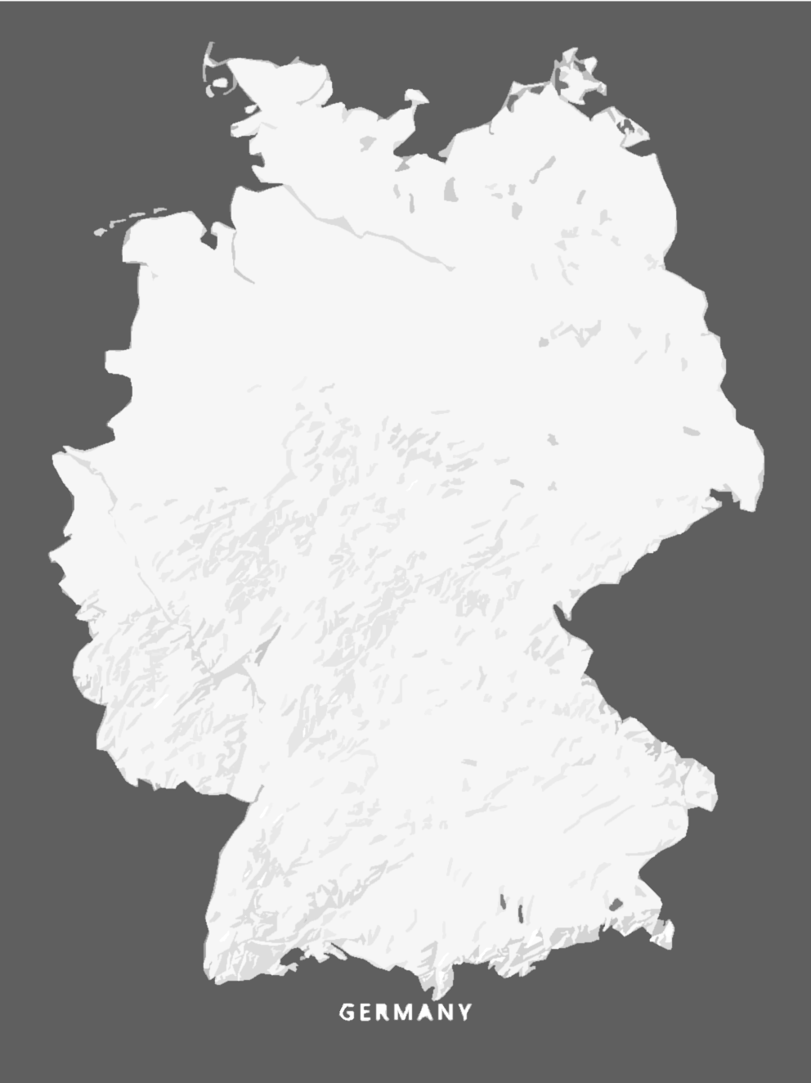
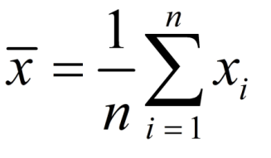
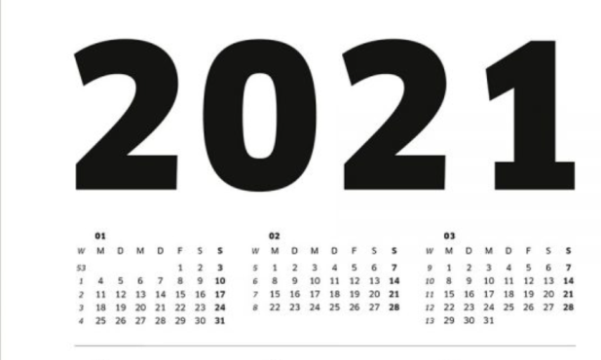
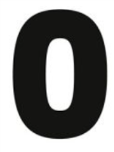
Plant Breeding: we want to predict performance „G“ of our entries in cv.‘s marketing area and marketing time from current data („P“).
Regression between G and P = h² heritability
Mean value across the target area of environments; „G“ value
L=1
Y=1
R=4
Broad sense heritability h² = ?
5
5

Slide 6

What is heritability?
h² is one of two (or three) parameters in the breeders equation
R = h² ∙ S
R = h² ∙ i ∙ σ_{P}
S = Selection Differential (predict S if data follow the Gauss‘ distribution)
Heritability is a transmission factor. It tells how much of S will be transferred ...
Berries‘ content of soluble compound in ‰
Grape vine, offspring from crosses
S
Grape vine, P1‘s of many crosses

Slide 7
What is heritability?
R = h² ∙ S
R = h² ∙ i ∙ σ_{P}
But:
Transfer to phenotypic data of offspring? Rather not.
Transfer is from
‚data we have as breeders‘ to
‚the truth we do not have as breeders‘.
Transfer is to the unknown genetic values.
In Plant Breeding, we take the average performance of the candidates – in the future seasons and in the regions of the farmers – as truth and thus as the genetic values.
We conduct field experiments in such a way that the results are as near as possible to that truth.
Berries‘ content of soluble compound in ‰
Grape vine, offspring from crosses
S
Grape vine, P1‘s of many crosses

Slide 8
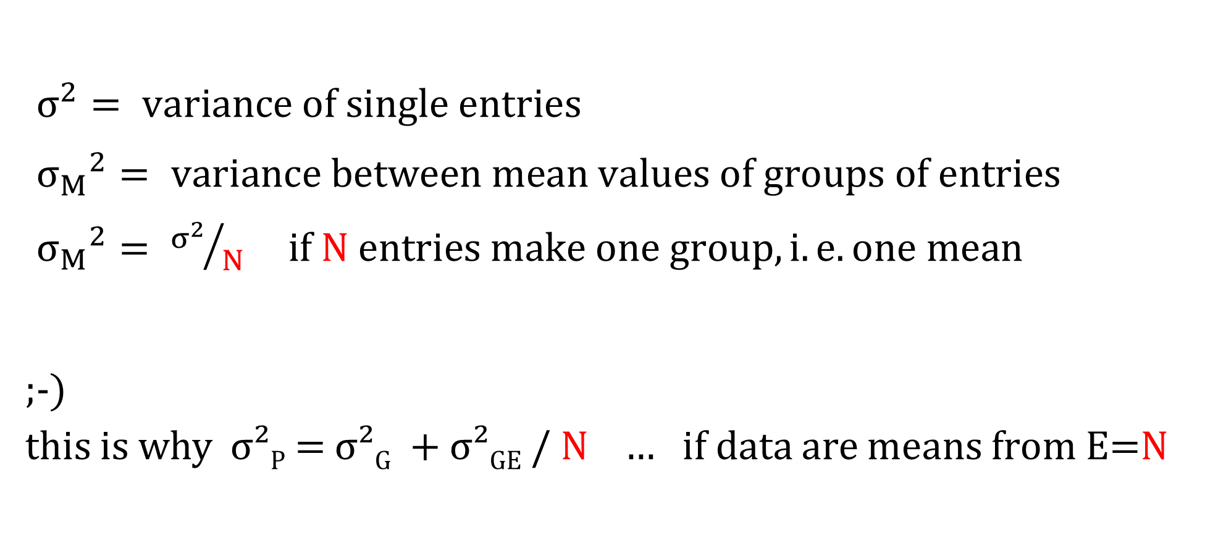
$σ^{2}= variance of single entries$
${σ_{M}}^{2}= variance between mean values of groups of entries$
${σ_{M}}^{2}= {σ^{2}}/N if N entries make one group, i.e. one mean$
;-)
this is why σ²_{P} = σ²_{G} + σ²_{GE} / N … if data are means from E=N

Slide 9
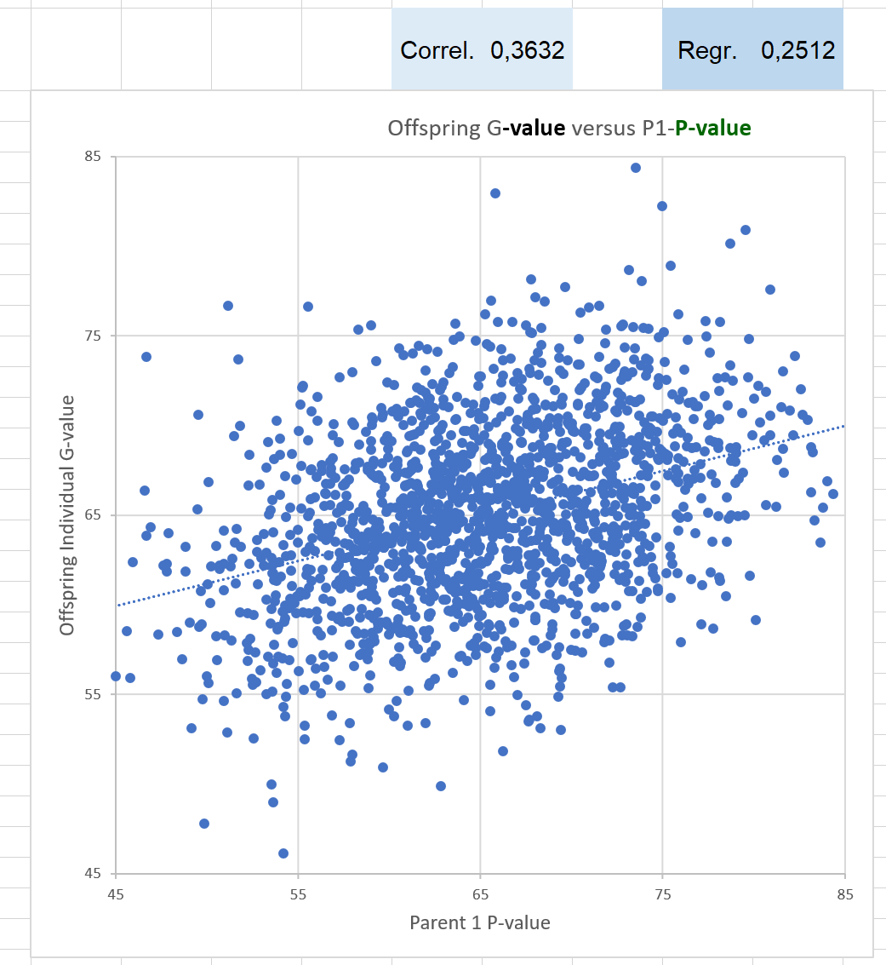
What is heritability?
Simulations
Genetic variance σ²_{G} = 25 σ²_{GE} = 25 σ²_{P} = 50 if phenotypic data are taken from E=1 (from one environment).
If phenotypic data are taken from E=5 environments, then σ²_{P} = σ²_{G} + σ²_{GE} / 5 … = 30
We take = σ²_{G} = σ²_{A} . Means σ²_{D} = zero.
σ²_{G} = σ²_{A} .
With this, we can calculate.
h² = σ²_{G} / σ²_{P} = 25/50 = 0.5 … phenotypic data from E=1.
h² = σ²_{G} / σ²_{P} = 25/30 = 0.83333 … phenotypic data from E=5.
h² = σ²_{G} / σ²_{P} = 25/26 = 0.96154 … phenotypic data from E=25.
In this run of the simulation, E=1, we had
r = 0.3632
R² = 0.1319
b = 0.2512 What does this now mean?
Offspring G value
Parent P1 value

Slide 10
What is heritability?
We calculate ...
h² = σ²_{G} / σ²_{P} = 25/50 = 0.5 … this is, if phenotypic data come from E=1.
Why is regression here (between G-value of offspring and P-value of one-parent) so low, it is about ½ ∙ h² ?
This is because we have only one parent on X-axis (the other parent is random).
The regression here shows b = h²/2.
b_{OG.PP1} = h²/2
h² = 2 ∙ b_{OG.PP1} = 0.5024
that’s okay since our parameters say h² = 0.5

Slide 11
What is heritability?
We calculate ...
h² = σ²_{G} / σ²_{P} = 25/50 = 0.5 … this is, if phenotypic data come from E=1.
Why is regression here (between G-value of offspring and P-value of one-parent) so low, it is about ½ ∙ h² ?
This is because we have only one parent on X-axis (the other parent is random).
The regression here shows b = h²/2.
b_{OG.PP1} = h²/2
h² = 2 ∙ b_{OG.PP1} = 0.5024
that’s okay since our parameters say h² = 0.5
Correlation
ρ = 0.5 (h²)^{0.5} = 0.5 h

Slide 12
What is heritability?
β _{GO-PP1} = 0.5 σ²_{G} / σ²_{P} => β = 0.5 h²
With our parameters, the correlation ρ should be
[0.5 ∙ 25] / [(25)^{0.5} ∙ (25+25)^{0.5}] = 0.354
Simulation actually says r = 0.3632
With our parameters, the regression β should be
[0.5 ∙ 25] / (5 ∙ 5) = 0.25
Simulation actually says b = 0.2512
With our parameters, h² should be
25 / (25+25) = 0.5
Simulations says:
h² = 0.5277 based on the correlation
h² = 0.5024 based on the regression

Slide 13
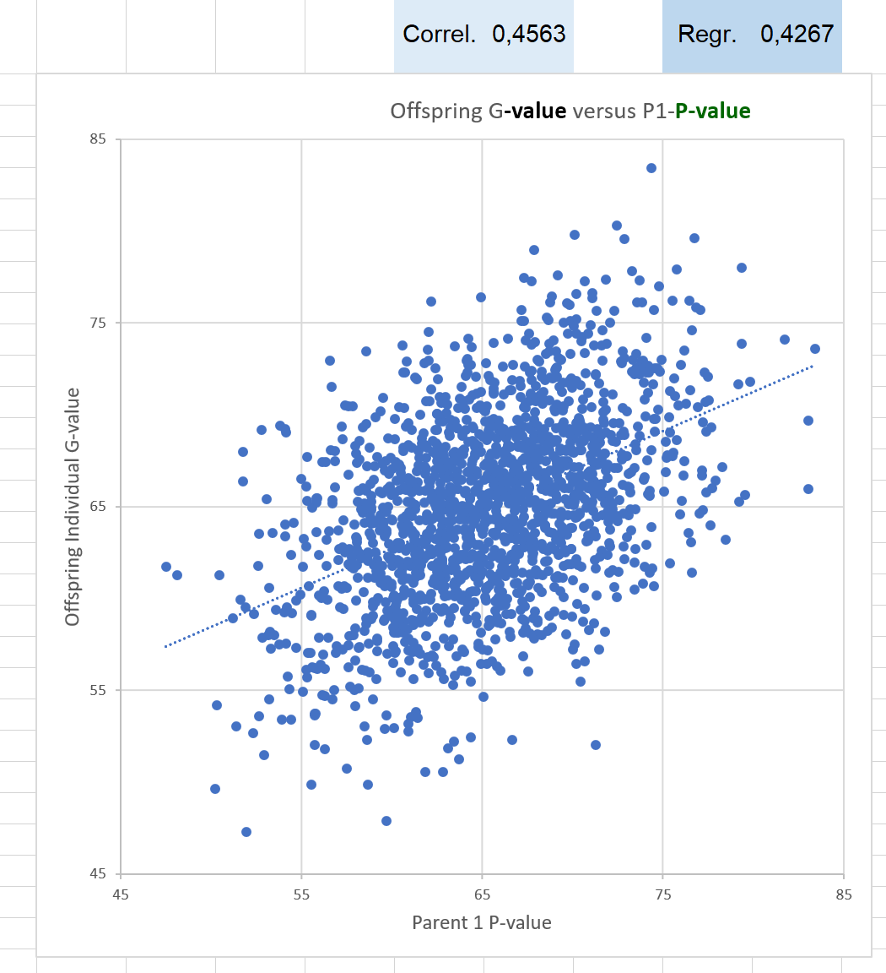
What is heritability?
The same setting: one parent vs. one offspring.
Phenotypic data for P1 and G date for offspring.
But: parent-data are means from E=5 environments,
With our parameters, the correlation ρ should be
[0.5 ∙ 25] / [(25)^{0.5} ∙ {(25+25/5)}^{0.5}] = 0.456
Simulation actually says r = 0.4563
With our parameters, the regression β should be
[0.5 ∙ 25] / (25+5) = 0.4166667
Simulation actually says b = 0.4267
With our parameters, h² should be
25 / (25+25) = 5/6 = 0.833333
Simulations says:
h² = 0.8534 based on the regression
h² = 0.8328 based on the correlation

Slide 14
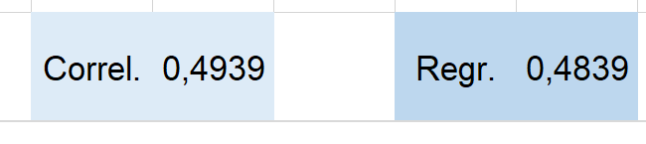
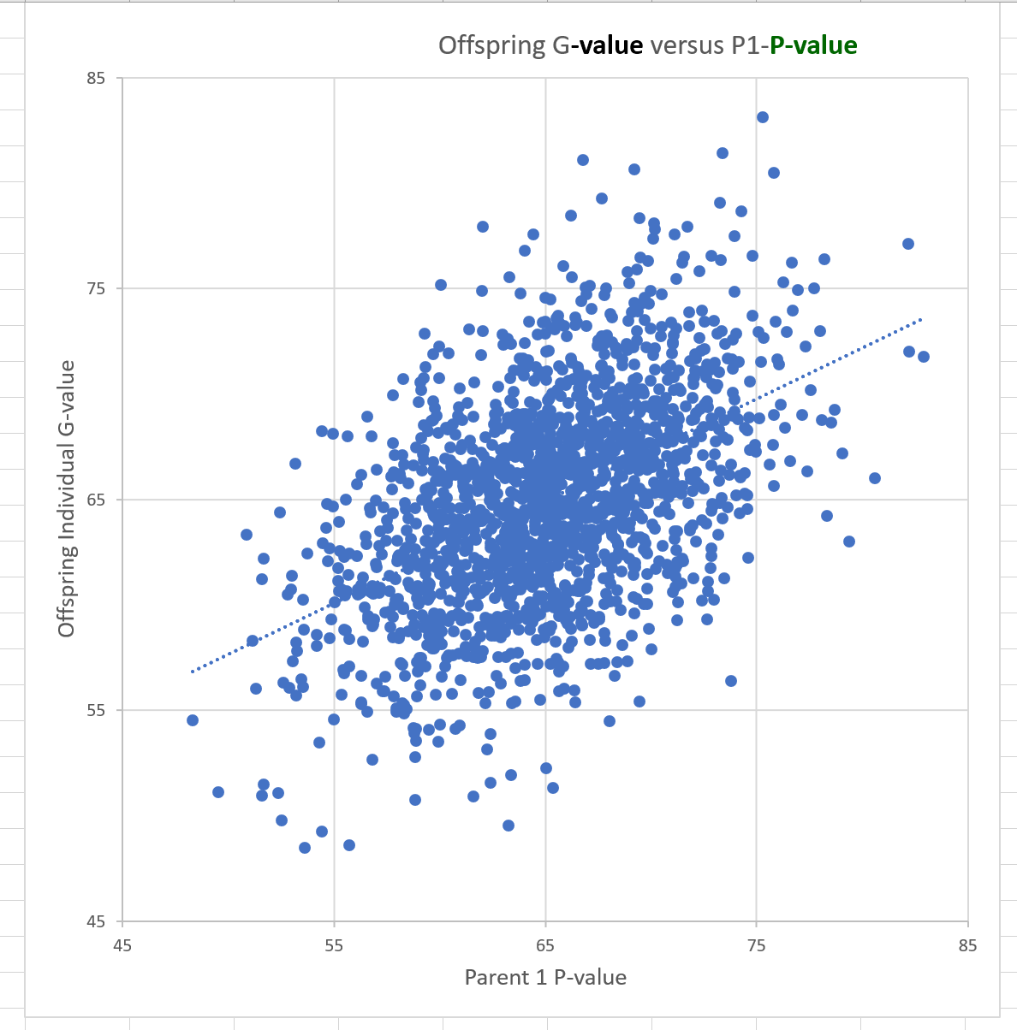
What is heritability?
The same setting: one parent vs. one offspring.
Phenotypic data for P1 and G date for offspring.
But: parent-data are means from E=25 environments,
With our parameters, the correlation ρ should be
[0.5 ∙ 25] / [(25)^{0.5} ∙ {(25+25/25)}^{0.5}] = 0.4903
Simulation actually says r = 0.4939
With our parameters, the regression β should be
[0.5 ∙ 25] / (25+1) = 0.48076
Simulation actually says b = 0.4839
With our parameters, h² should be
25 / (25+1) = 0.9615
Simulations says:
h² = 0.9678 based on the regression
h² = 0.9757 based on the correlation

Slide 15
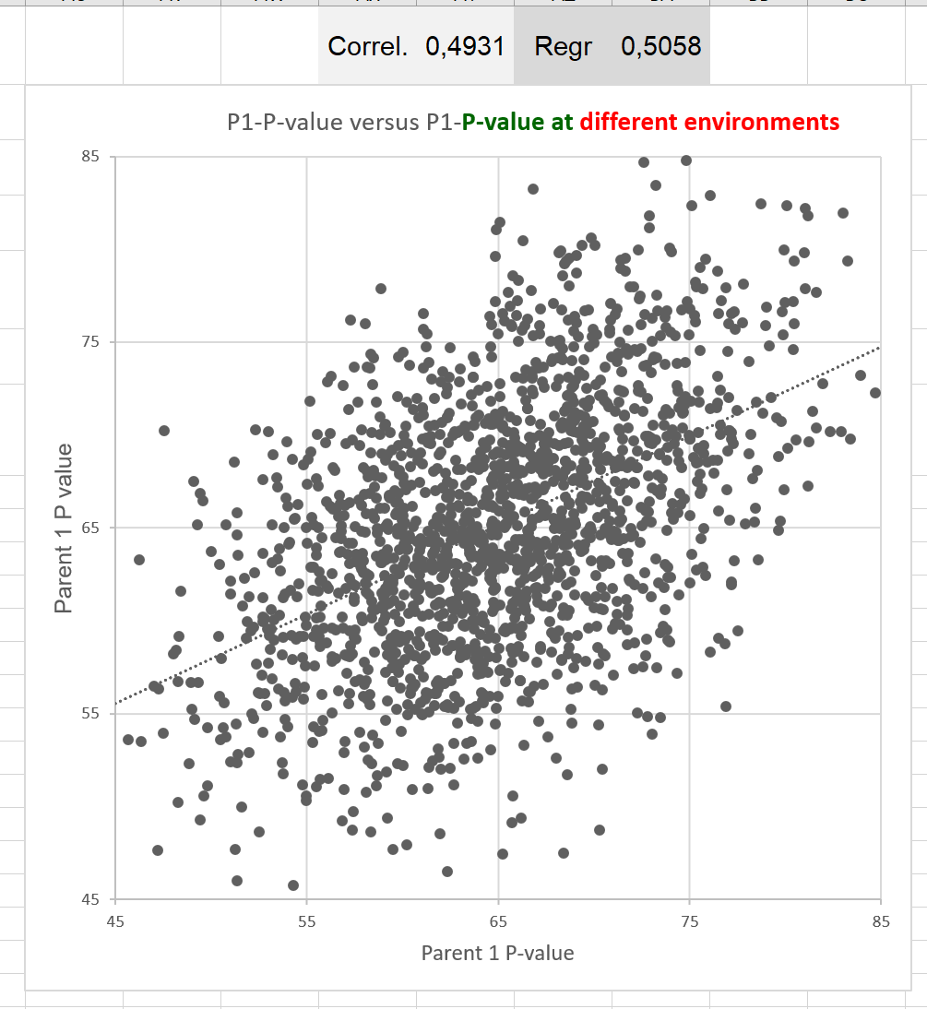
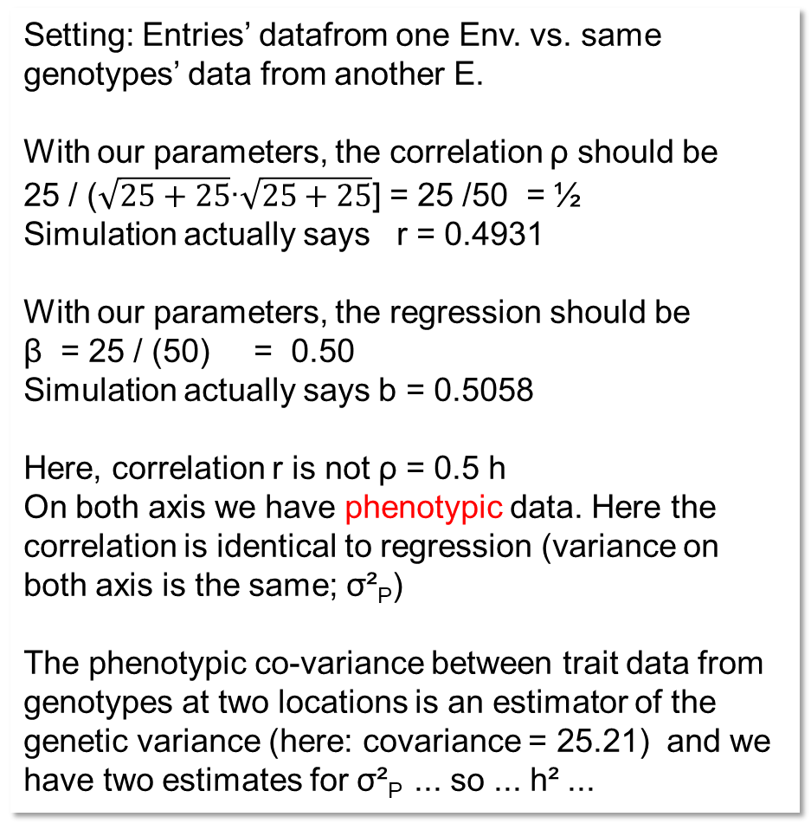
Setting: Entries’ datafrom one Env. vs. same genotypes’ data from another E.
With our parameters, the correlation ρ should be
25 / ($\sqrt{25+25}$∙$\sqrt{25+25}$] = 25 /50 = ½
Simulation actually says r = 0.4931
With our parameters, the regression should be
β = 25 / (50) = 0.50
Simulation actually says b = 0.5058
Here, correlation r is not ρ = 0.5 h
On both axis we have phenotypic data. Here the correlation is identical to regression (variance on both axis is the same; σ²_{P})
The phenotypic co-variance between trait data from genotypes at two locations is an estimator of the genetic variance (here: covariance = 25.21) and we have two estimates for σ²_{P} ... so ... h² ...

Slide 16
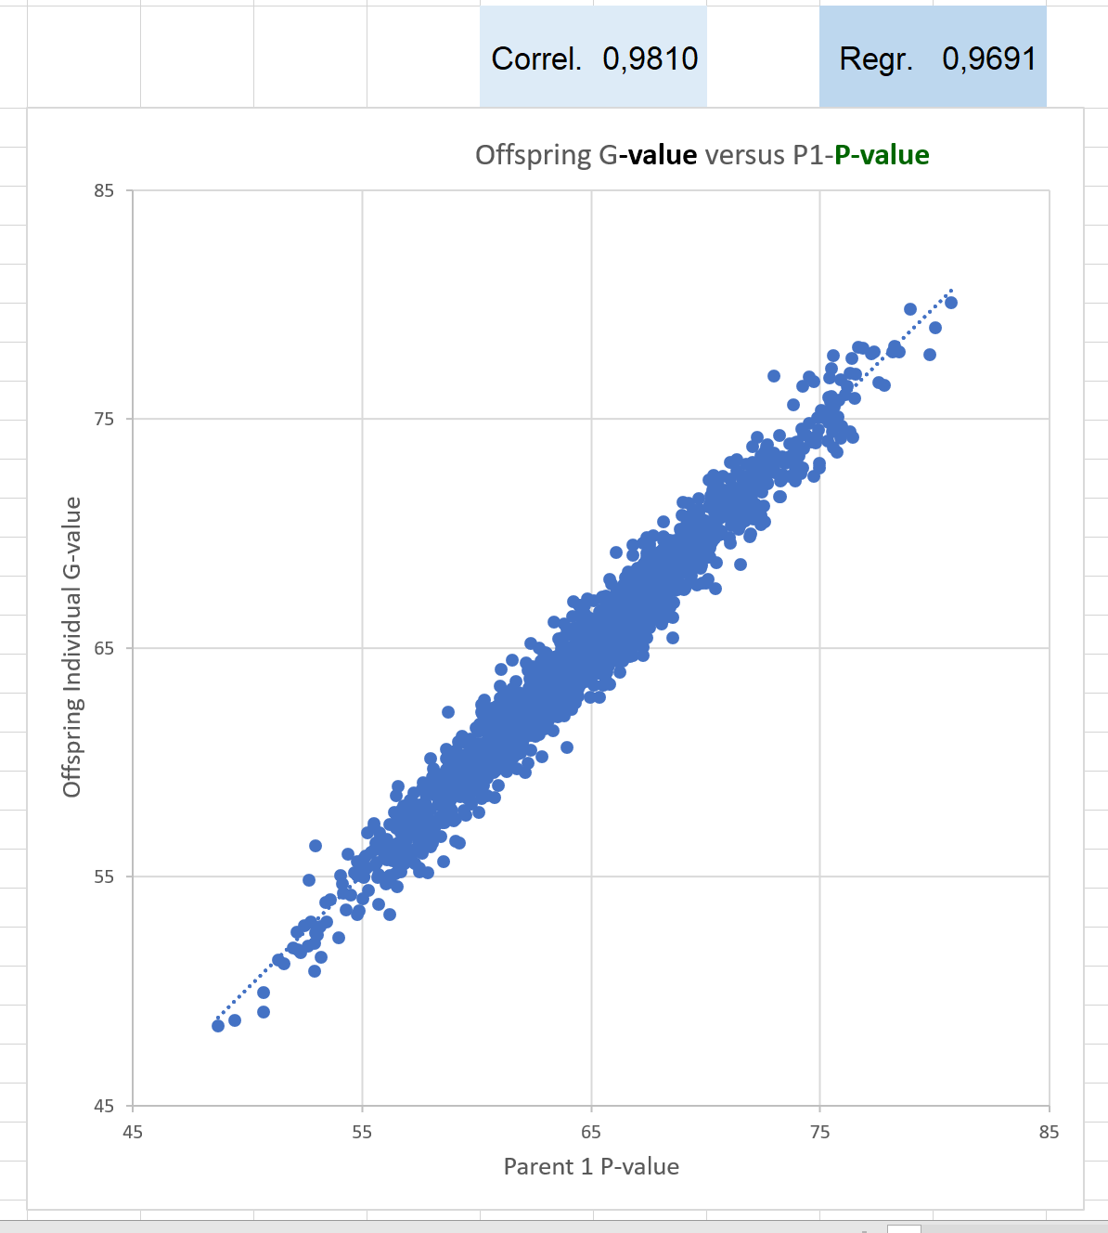
Setting: Same genotype on both axes.
Phenotypic data for P1 and G date for P1.
But: x-axes data are means from E=25 environments
With our parameters, the correlation ρ should be
[25] / [(25)^{0.5} ∙ {(25+25/25)}^{0.5}] = 0.9805807
Simulation actually says r = 0.9810
r estimated h, not h/2, because both axes same genotype
With our parameters, the regression β should be
[25] / (25+1) = 0.0.9615
Simulation actually says b = 0.9691
With our parameters, h² should be
25 / (25+1) = 0.9615
Simulations says:
h² = 0.9691 based on the regression
h² = 0.9624 based on the correlation
P1 G- data
P1 data from E=25

Slide 17
This here is to visually contemplate how come that …
If offspring is individual hence the segregation inside families is realized and variance on Y axis is large (σ²_{G})
why then the regression steepness is the same as if we took
the family means on Y-asis with much lowered variance on Y-axis.

Slide 18
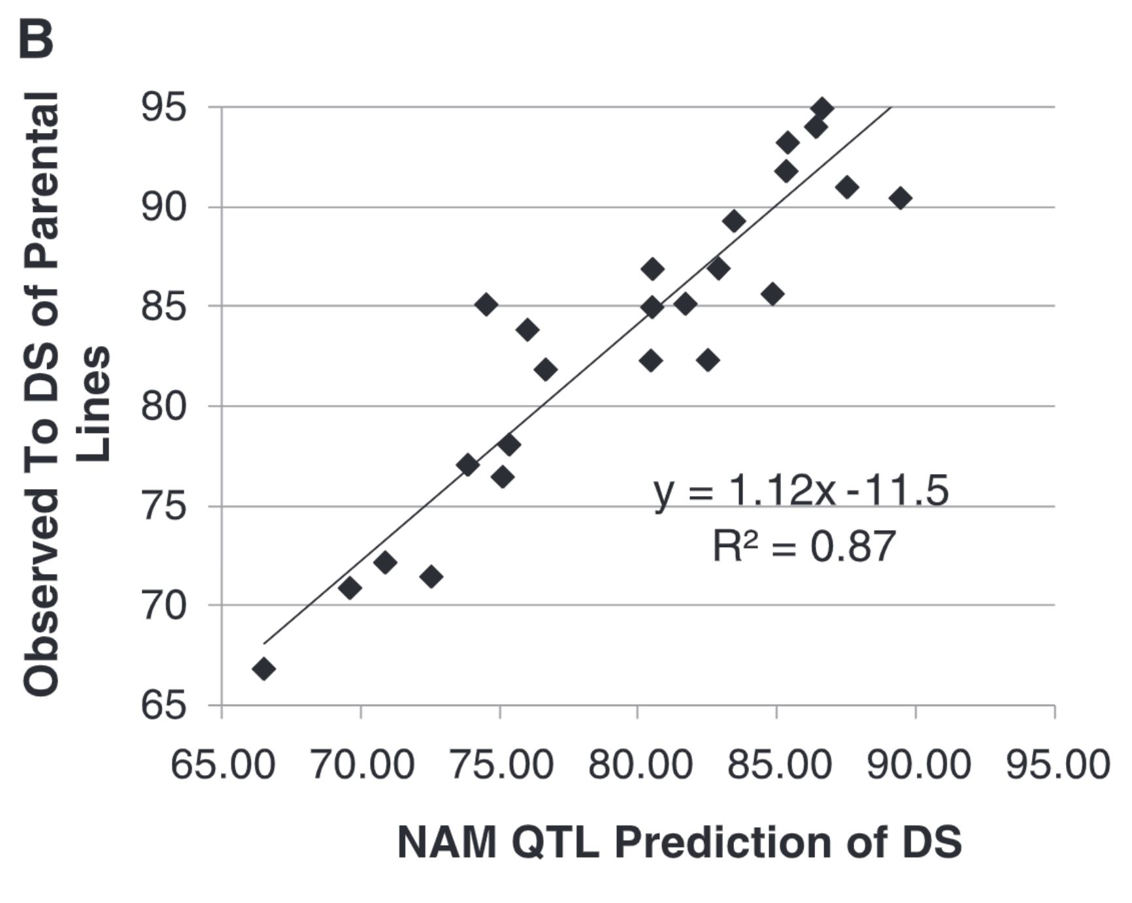
Buckler et al., 2009 (‚NAM …‘;
39 QTL for days of silking DS)
15cm
22cm

Slide 19
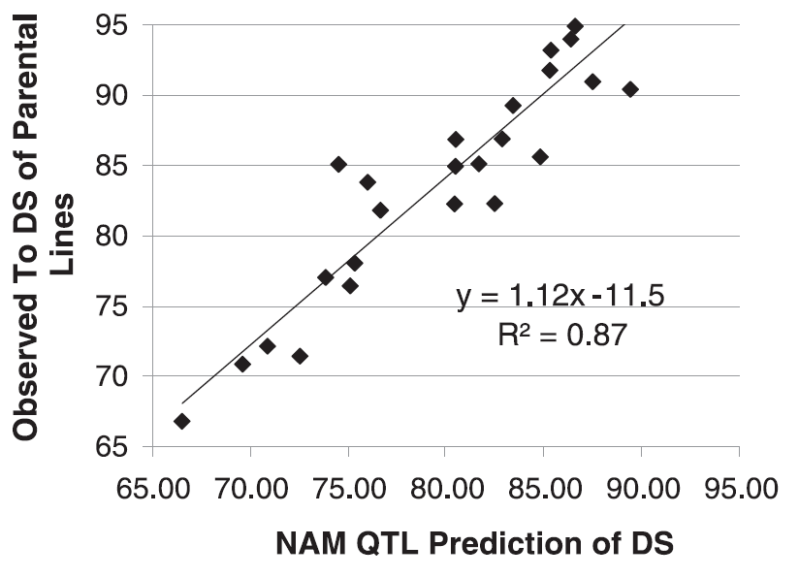
Phentoypic data (flowering)
Marker score M_{y} of trait (flowering) in corn

Slide 20
h²=0.94
… and see, the phenotypic variance of the trait is more ore less the genotypic variance (h²=0.94)
Is this regression here a kind of heritability? For each unit on X-axis you get 1.12 units on Y-axis.
A ‚normal‘ h² is 0 < h² < 1. Is 1.12 ‘true’ or just an estimate of something that should be 1.0?!
The correlation between Marker Score and phenotype is the so-called predictive ability
Here; r = 0.93
Phentoypic data (flowering)
=> r=0.93
The variance between the marker scores is only 87% of the phenotypic variance …

Slide 21
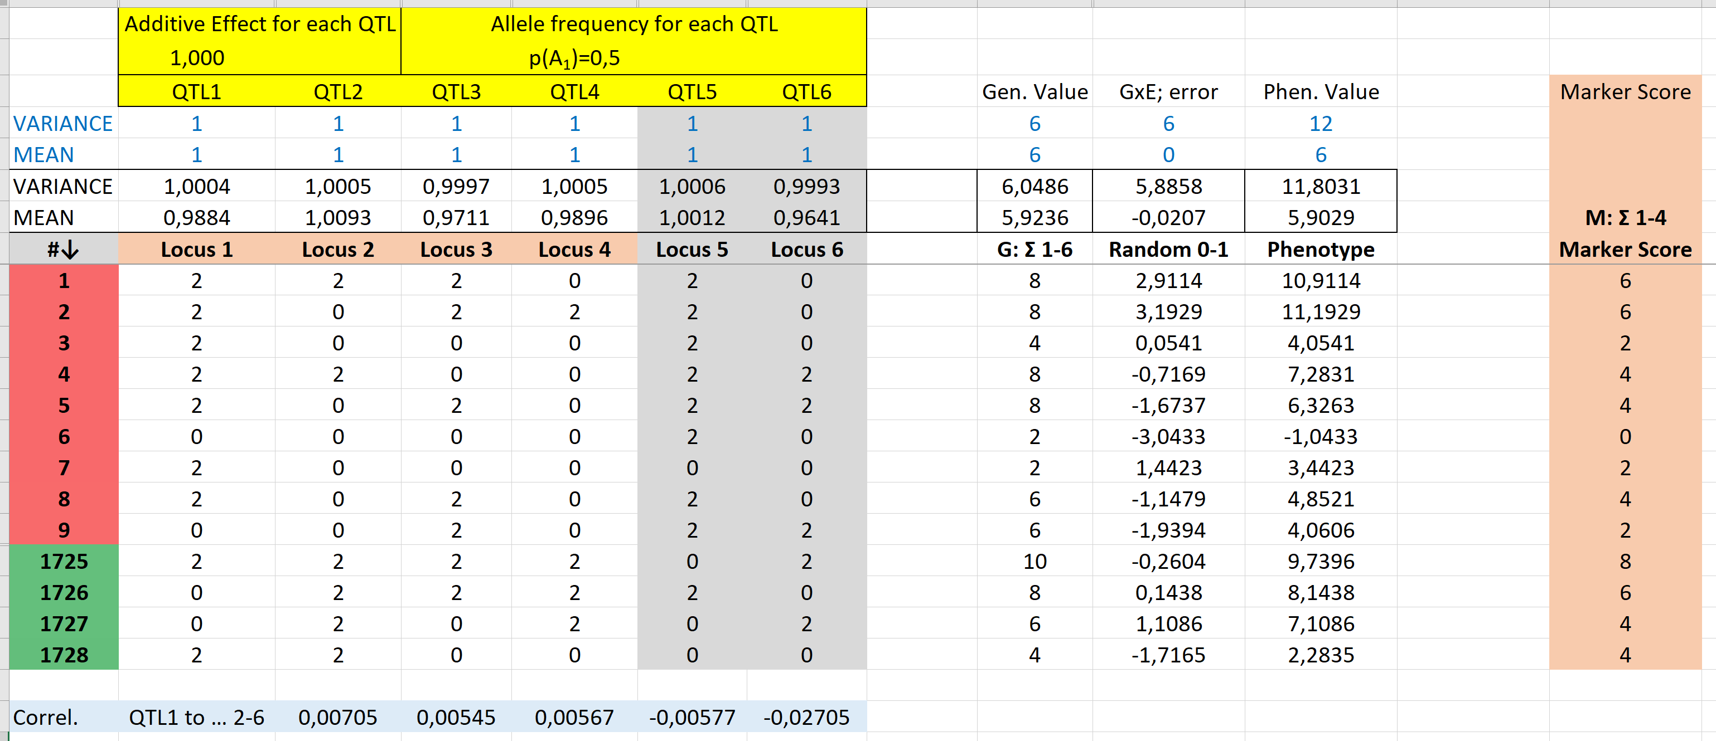
Simulate 6 loci, uncorrelated, same effect size, same variance. Their sum makes the genotypic value.
Simulate one error term with same variance (σ²=6). Take P=G+E for each entry.

Slide 22
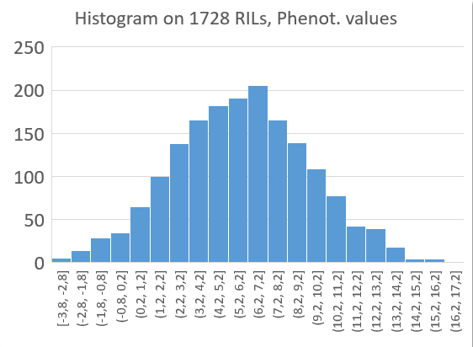
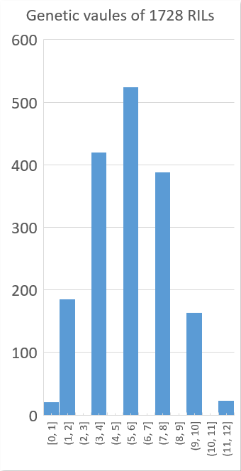
Distribution of the G values (from 0 to 12) and
of the P values (from -4.8 to +17.5)
-5
17.5

Slide 23
Un-marked, hidden genetic variance
Variance (Marker Score) = 4 (SD=2; µ=4.0)
Variance (Genetic Values) = 6 (SD=2.45; µ=6.0)

Slide 26

The correlation between Marker Score and the phenotypic value is called „Predictive ability ρ“
ρ = σ²_{M} / (σ_{M} ∙ σ_{P}) = σ_{M} / σ_{P}
Here:
ρ = 4 / (4 ∙ 12)^{½} = 0.5774
The Accuracy is like ρ: yet, is divided by h = $\sqrt{h^{2}}$
here with E=1; h² = 0.5
The Accuracy is Predictive ability divided by h = ρ /$\sqrt{h^{2}}$
Acc. = [σ²_{M} / (σ_{M} ∙ σ_{P}] / [σ_{G} / σ_{P}]
Acc. = [σ²_{M} / {(σ_{M} ∙ (σ_{P} ∙ h)} = [σ²_{M} / {(σ_{M} ∙ (σ_{G})}
Acc. = correlation G to M
Accuracy is correlation between Marker Score and the genetic value.
Acc. = σ_{M} / σ_{G}
Acc. here: = 0.5774 / (0.5)^{½} = 0.8165
Acc. here: = (4)^{½} / (6)^{½} = 0.8165

Slide 27
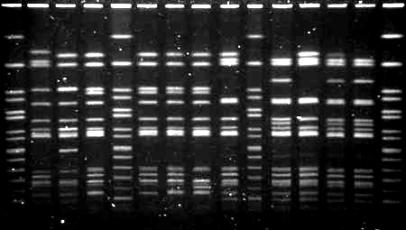
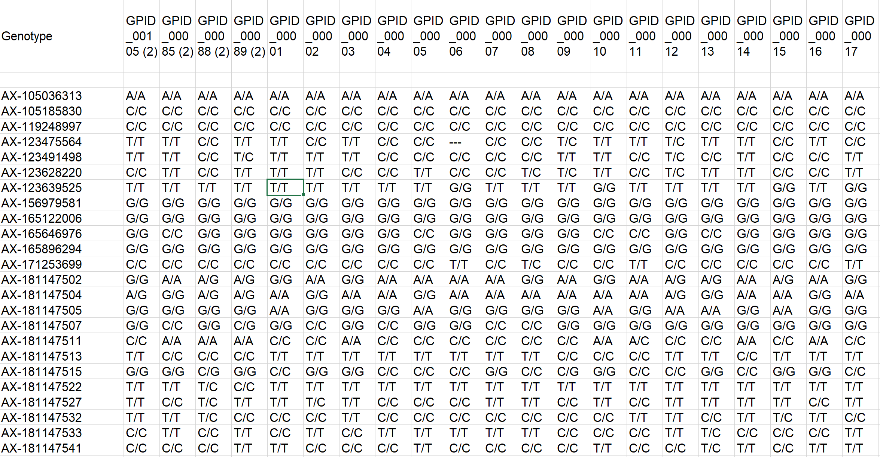
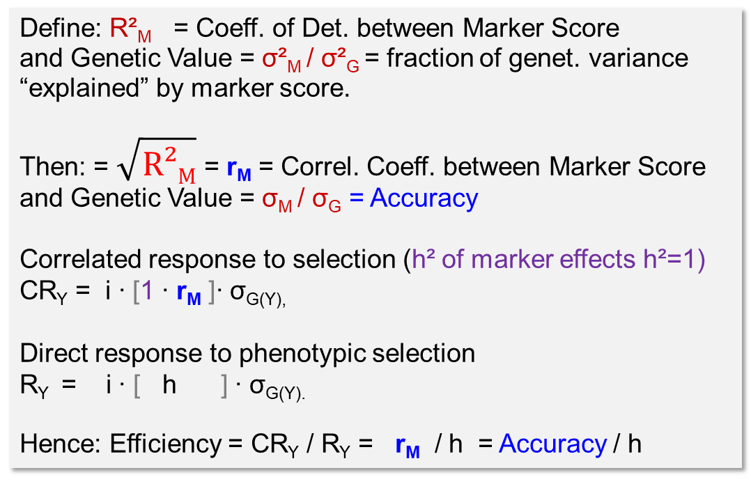
1 2 3 4 5 6 7 8 9 10 11 12 13 14 15
The correlation between Marker Score and the phenotypic value is called „Predictive ability ρ“
Pred. ability ρ = σ_{M} / σ_{P}
Accuracy = σ_{M} / σ_{G}
Define: R²_{M} = Coeff. of Det. between Marker Score
and Genetic Value = σ²_{M} / σ²_{G} = fraction of genet. variance “explained” by marker score.
Then: = $\sqrt{R²M}$ = r_{M} = Correl. Coeff. between Marker Score and Genetic Value = σ_{M} / σ_{G} = Accuracy
Correlated response to selection (h² of marker effects h²=1)
CR_{Y} = i ∙ [1 ∙ r_{M} ]∙ σ_{G(Y),}
Direct response to phenotypic selection
R_{Y} = i ∙ [ h ] ∙ σ_{G(Y).}
Hence: Efficiency = CR_{Y} / R_{Y} = r_{M} / h = Accuracy / h

Slide 28
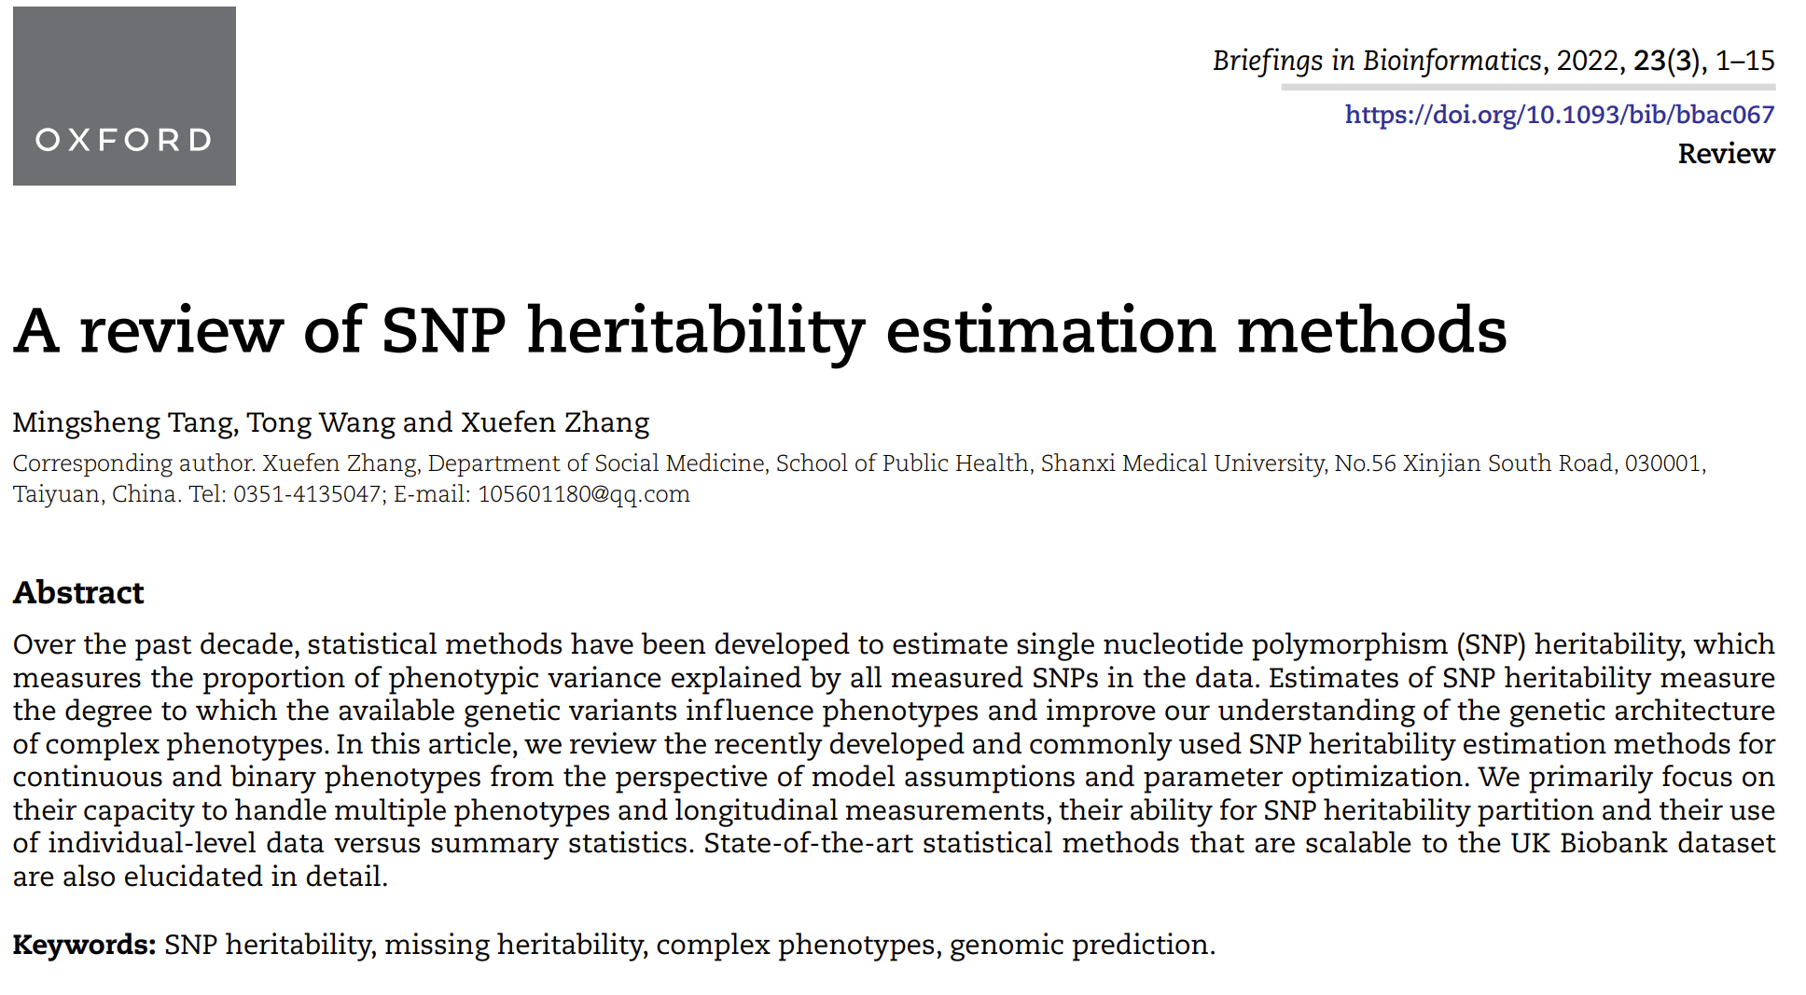

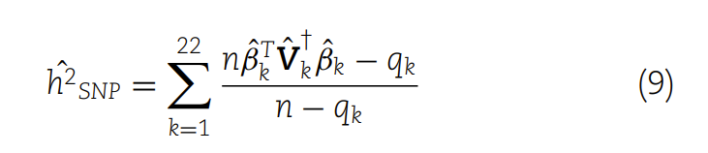
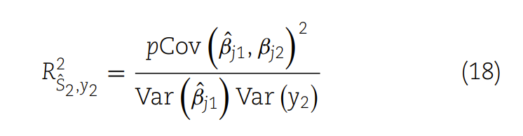
And now ..
What is then SNP-based h² ?
SNP-based h² is … of course
h²_{M} = σ²_{M} / σ²_{P} = (Predictive ability)² = ρ²
Conventional h² = σ²_{G} / σ²_{P}
and – again – therefore …
h²_{M} = (σ²_{G} / σ²_{P}) ∙ (Accuracy)² = h² ∙ (Accuracy)²
h²_{M} = (σ²_{G} /σ²_{P}) ∙ (σ_{M}/ σ_{G} )² = σ²_{M} / σ²_{P} = Heritab. of Marker Score
As soon as accuracy = acc=1,0 ... we have ‚all‘ genetic variation grasped by genomic prediction and the genetic variance is identical to the marker-variance.
All the stories about ‘missing heritability’ and ‘Omnigenetics’ and even about ‘dominance variance’, about substituting pedigree relatedness by SNP-based similarity estimates, and IBD and AIS … and estimating h² from variation of DNA-based similarity, and further blurring stories about how-to-impute and about BLUP and BLUE and mixed-linear-models and ... were blurring my view on the rather simple essence-of-things  ... alas.
What-is then SNP-based h² ?

Slide 29
finish

